Slide 1

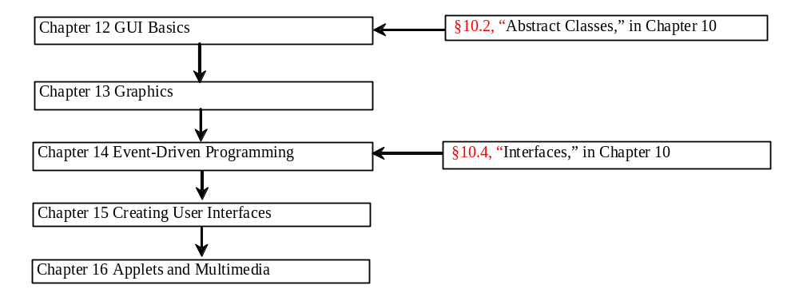
Chapter 14 Event-Driven Programming

Slide 2
Objectives
To start with event-driven programming with a simple example (§14.1).
To explain the concept of event-driven programming (§14.2).
To understand events, event sources, and event classes (§14.2).
To declare listener classes and write the code to handle events (§14.3).
To register listener objects in the source object (§11.3).
To understand how an event is handled (§14.3).
To write programs to deal with ActionEvent (§14.3).
To write programs to deal with MouseEvent (§14.4).
To write programs to deal with KeyEvent (§14.5).
To use the Timer class to control animations (§14.6 Optional).

Slide 3
Procedural vs. Event-Driven Programming
Procedural programming is executed in procedural order.
In event-driven programming, code is executed upon activation of events.

Slide 4
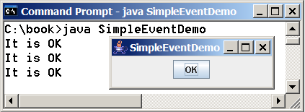
Taste of Event-Driven Programming
The example displays a button in the frame. A message is displayed on the console when a button is clicked.
SimpleEventDemo
Run

Slide 5
Events
An event can be defined as a type of signal to the program that something has happened.
The event is generated by external user actions such as mouse movements, mouse clicks, and keystrokes, or by the operating system, such as a timer.

Slide 6
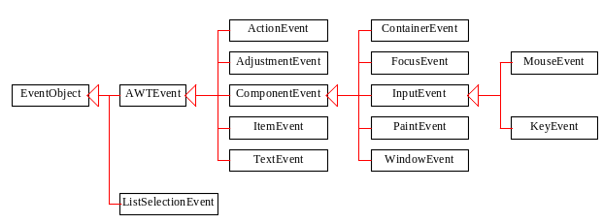
Event Classes

Slide 7
Event Information
An event object contains whatever properties are pertinent to the event. You can identify the source object of the event using the getSource() instance method in the EventObject class. The subclasses of EventObject deal with special types of events, such as button actions, window events, component events, mouse movements, and keystrokes. Table 14.1 lists external user actions, source objects, and event types generated.

Slide 8
Selected User Actions
Source Event Type
User Action Object Generated
Click a button JButton ActionEvent
Click a check box JCheckBox ItemEvent, ActionEvent
Click a radio button JRadioButton ItemEvent, ActionEvent
Press return on a text field JTextField ActionEvent
Select a new item JComboBox ItemEvent, ActionEvent
Window opened, closed, etc. Window WindowEvent
Mouse pressed, released, etc. Component MouseEvent
Key released, pressed, etc. Component KeyEvent

Slide 9
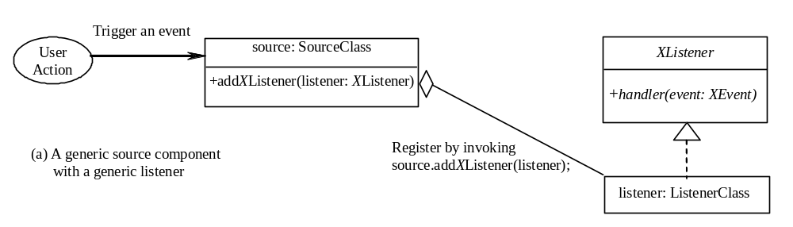
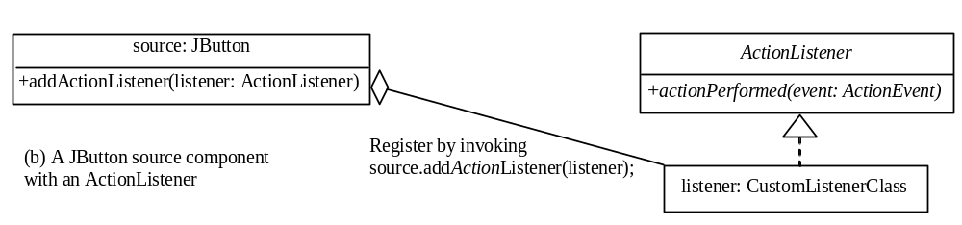
The Delegation Model

Slide 10
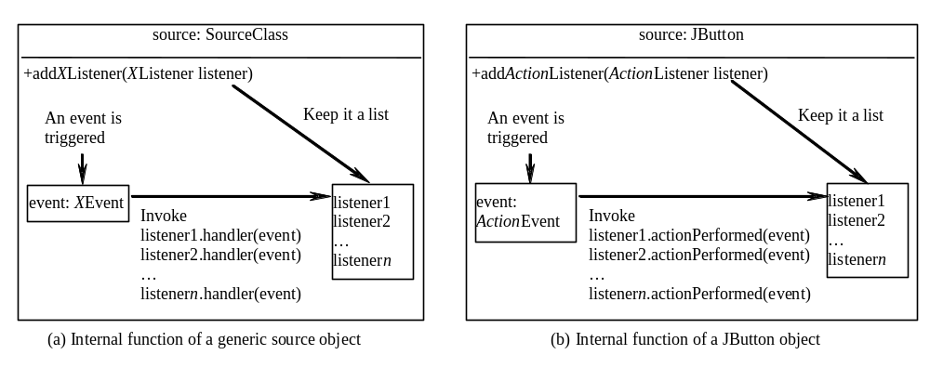
Internal Function of a Source Component

Slide 11
The Delegation Model: Example
JButton jbt = new JButton("OK");
ActionListener listener = new OKListener();
jbt.addActionListener(listener);

Slide 12
Selected Event Handlers
Event Class Listener Interface Listener Methods (Handlers)
ActionEvent ActionListener actionPerformed(ActionEvent)
ItemEvent ItemListener itemStateChanged(ItemEvent)
WindowEvent WindowListener windowClosing(WindowEvent)
windowOpened(WindowEvent)
windowIconified(WindowEvent)
windowDeiconified(WindowEvent)
windowClosed(WindowEvent)
windowActivated(WindowEvent)
windowDeactivated(WindowEvent)
ContainerEvent ContainerListener componentAdded(ContainerEvent)
componentRemoved(ContainerEvent) MouseEvent MouseListener mousePressed(MouseEvent)
mouseReleased(MouseEvent)
mouseClicked(MouseEvent)
mouseExited(MouseEvent)
mouseEntered(MouseEvent)
KeyEvent KeyListener keyPressed(KeyEvent)
keyReleased(KeyEvent)
keyTypeed(KeyEvent)

Slide 13
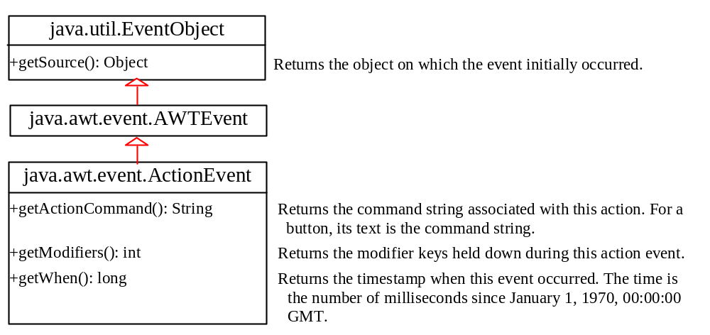
java.awt.event.ActionEvent

Slide 14
Inner Class Listeners
A listener class is designed specifically to create a listener object for a GUI component (e.g., a button). It will not be shared by other applications. So, it is appropriate to define the listener class inside the frame class as an inner class.

Slide 15
Inner Classes
Inner class: A class is a member of another class.
Advantages: In some applications, you can use an inner class to make programs simple.
An inner class can reference the data and methods defined in the outer class in which it nests, so you do not need to pass the reference of the outer class to the constructor of the inner class.
ShowInnerClass

Slide 16
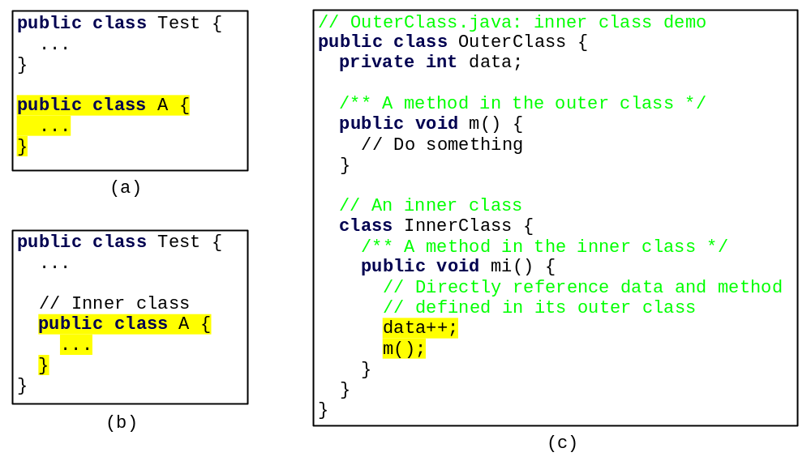
Inner Classes, cont.

Slide 17
Inner Classes (cont.)
Inner classes can make programs simple and concise.
An inner class supports the work of its containing outer class and is compiled into a class named OuterClassName$InnerClassName.class. For example, the inner class InnerClass in OuterClass is compiled into OuterClass$InnerClass.class.

Slide 18
Inner Classes (cont.)
An inner class can be declared public, protected, or private subject to the same visibility rules applied to a member of the class.
An inner class can be declared static. A static inner class can be accessed using the outer class name. A static inner class cannot access nonstatic members of the outer class

Slide 19
Revising SimpleEventDemo Using Inner Classes
SimpleEventDemoInnerClass
Run

Slide 20
Anonymous Inner Classes
An anonymous inner class must always extend a superclass or implement an interface, but it cannot have an explicit extends or implements clause.
An anonymous inner class must implement all the abstract methods in the superclass or in the interface.
An anonymous inner class always uses the no-arg constructor from its superclass to create an instance. If an anonymous inner class implements an interface, the constructor is Object().
An anonymous inner class is compiled into a class named OuterClassName$n.class. For example, if the outer class Test has two anonymous inner classes, these two classes are compiled into Test$1.class and Test$2.class.

Slide 21
Anonymous Inner Classes (cont.)
Inner class listeners can be shortened using anonymous inner classes. An anonymous inner class is an inner class without a name. It combines declaring an inner class and creating an instance of the class in one step. An anonymous inner class is declared as follows:
new SuperClassName/InterfaceName() {
// Implement or override methods in superclass or interface
// Other methods if necessary
}

Slide 22
Revising SimpleEventDemo Using Anonymous Inner Classes
SimpleEventDemoAnonymousInnerClass
Run

Slide 23
Example: Handling Simple Action Events
Objective: Display two buttons OK and Cancel in the window. A message is displayed on the console to indicate which button is clicked, when a button is clicked.
TestActionEvent
Run

Slide 24
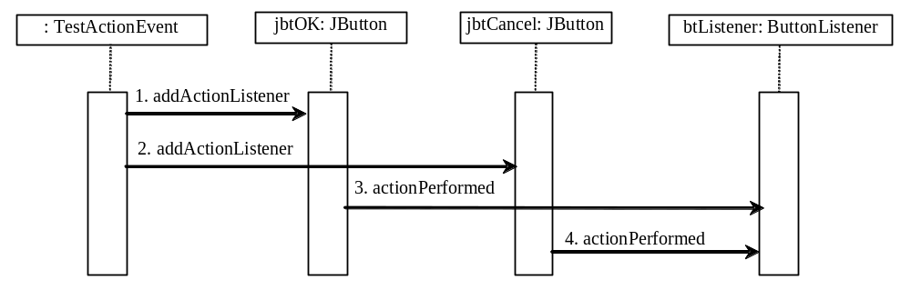
Interaction Between Source and Listener
  jbtOK registers btListener by invoking addActionListener(btListner).
  jbtCancel registers btListener by invoking addActionListener(btListner).
  jbtOK invokes btListener’s actionPerformed method to process an ActionEvnet.
  jbtCancel invokes btListener’s actionPerformed method to process an ActionEvent.

Slide 25
Example: Handling Window Events
Objective: Demonstrate handling the window events. Any subclass of the Window class can generate the following window events: window opened, closing, closed, activated, deactivated, iconified, and deiconified. This program creates a frame, listens to the window events, and displays a message to indicate the occurring event.
TestWindowEvent
Run

Slide 26
Example: Multiple Listeners for a Single Source
Objective: This example modifies Listing 14.1 to add a new listener for each button. The two buttons OK and Cancel use the frame class as the listener. This example creates a new listener class as an additional listener for the action events on the buttons. When a button is clicked, both listeners respond to the action event.
TestMultipleListener
Run

Slide 27
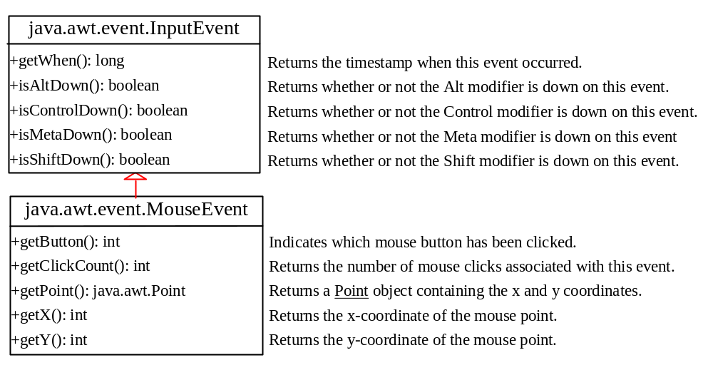
MouseEvent

Slide 28
Handling Mouse Events
Java provides two listener interfaces, MouseListener and MouseMotionListener, to handle mouse events.
The MouseListener listens for actions such as when the mouse is pressed, released, entered, exited, or clicked.
The MouseMotionListener listens for
actions such as dragging or moving the
mouse.

Slide 29
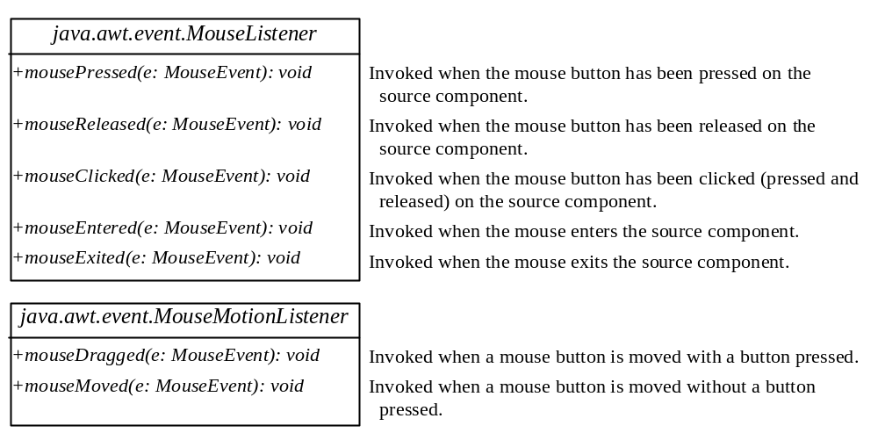
Handling Mouse Events

Slide 30
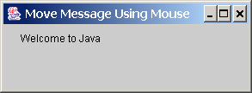
Example: Moving Message Using Mouse
Objective: Create a program to display a message in a panel. You can use the mouse to move the message. The message moves as the mouse drags and is always displayed at the mouse point.
MoveMessageDemo
Run

Slide 31
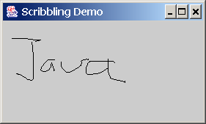
Example: (Omitted)
Handling Complex Mouse Events
Objective: Create a program for drawing using a mouse. Draw by dragging with the left mouse button pressed; erase by dragging with the right button pressed.
ScribbleDemo
Run

Slide 32
Handling Keyboard Events
To process a keyboard event, use the following handlers in the KeyListener interface:
keyPressed(KeyEvent e)
Called when a key is pressed.
keyReleased(KeyEvent e)
Called when a key is released.
keyTyped(KeyEvent e)
Called when a key is pressed and then
released.

Slide 33
The KeyEvent Class
Methods:
getKeyChar() method
getKeyCode() method
Keys:
Home VK_HOME
End VK_END
Page Up VK_PGUP
Page Down VK_PGDN
etc...

Slide 34
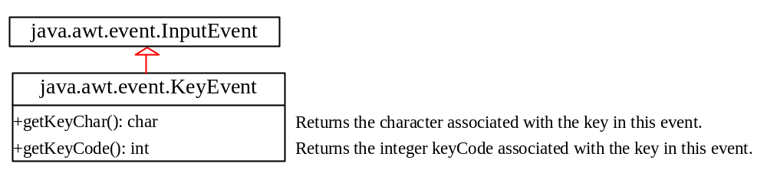
The KeyEvent Class, cont.

Slide 35
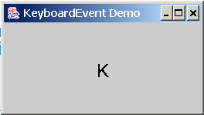
Example: Keyboard Events Demo
Objective: Display a user-input character. The user can also move the character up, down, left, and right using the arrow keys.
KeyEventDemo
Run

Slide 36
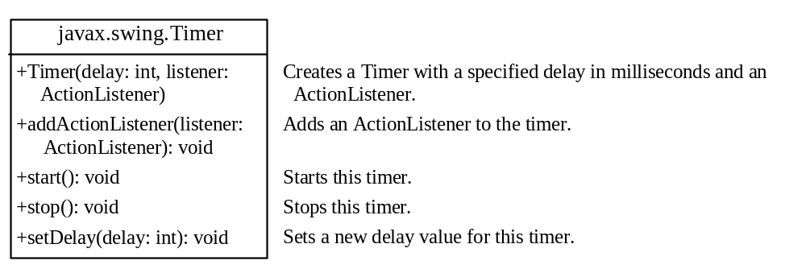
The Timer Class
Optional
Some non-GUI components can fire events. The javax.swing.Timer class is a source component that fires an ActionEvent at a predefined rate.
The Timer class can be used to control animations. For example, you can use it to display a moving message.
AnimationDemo
Run

Slide 37
Clock Animation
In Chapter 12, you drew a StillClock to show the current time. The clock does not tick after it is displayed. What can you do to make the clock display a new current time every second? The key to making the clock tick is to repaint it every second with a new current time. You can use a timer to control how to repaint the clock.
ClockAnimation
Run

